Slide 1
Development Toolchain
Fabian Schmidt
Notes:
Speak slowly and clearly!

Slide 2
Who am I?
Fabian Schmidt
8+ years Project Server & SharePoint developer
Developer @ Sensei Project Solutions
Office 365 – SharePoint Online & Project Online Consulting
Presentation about writing SharePoint extensions
  Options to create SharePoint extensions
  Not SharePoint Framework
Notes:
SharePoint extensions => because more than web part.
Strictly speaking not about SharePoint Framework. Cover this in the end.

Slide 3
What is my motivation?
Office 365 usage ramped up in past 18 months
  Request for usage enhancements
  Often small work packages
  Customers have similar issues
  Reusability is necessary
  Support for SharePoint web templating
Customer Situation
  Office 365 (SharePoint Online / Project Online)
  SharePoint & Project Server 2013
    often without app isolation
  SharePoint & Project Server 2010
Fast cadence of changes
Secret stash on consultant computer
Notes:
Small work package: between 1 day and 1 week effort.
Reusability much easier in Office365.
Special of Project is to use SharePoint site templates for Project workspaces. Solution must be part of the template.
Fast cadence: O365 changes. Deployment to prod daily / hourly.

Slide 4
Journey
SharePoint developer bubble
  Crusty toolchain
  Windows only
  Development on SharePoint Server local only
  Hard to automate
  Few Add in model usages
How others solve these issues?
Hunting for Open Source Software toolchain
  GitHub is your friend
  Cherry picking
  Good support by community
Notes:
Question: Who is a SharePoint developer?
Open Source Development
-over one year ago starting hunting for OSS best practices.
-Mainly web developers
Re-usable extension
Rapid Development
Continuous build
Continuous delivery
Release automation
Deployment automation
Cherry picking be careful too much good stuff.

Slide 5
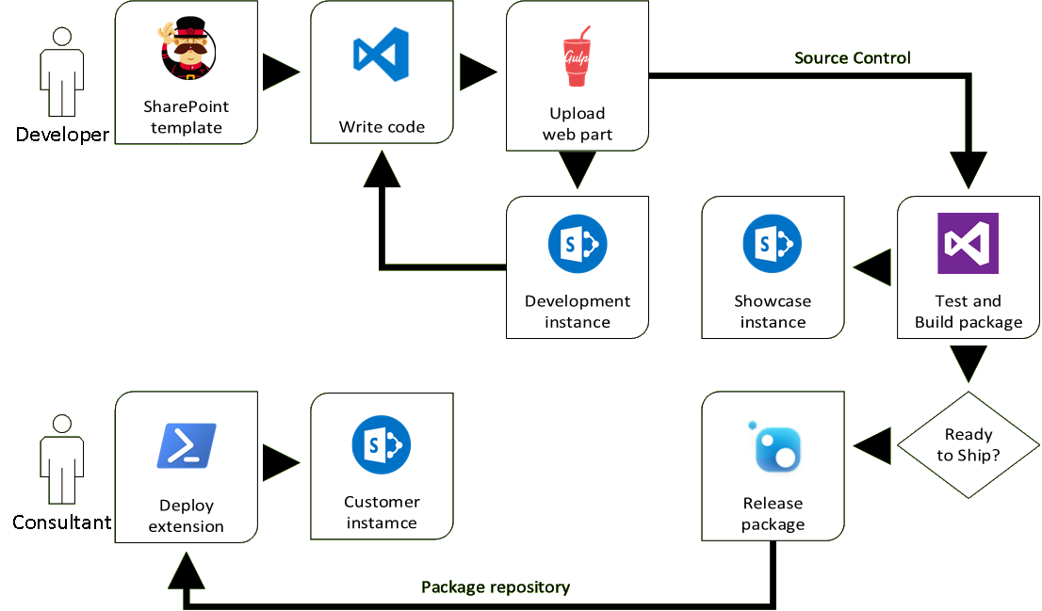
Solution
Notes:
Developer:
Yeoman (Node JS - templating tool) to create project based on template.
Writing in VS Code
Gulp (Nodes JS – Task runner) to
Type script compile
Combine and minimize files
Upload to SharePoint Online
Development in a separate SharePoint Online Dev instance.
Source Control VSTS
Auto deploy to a SharePoint Online Showcase instance.
Release via VSTS Release manager to a package repository.
Consultant small static PowerShell to deploy package.

Slide 6
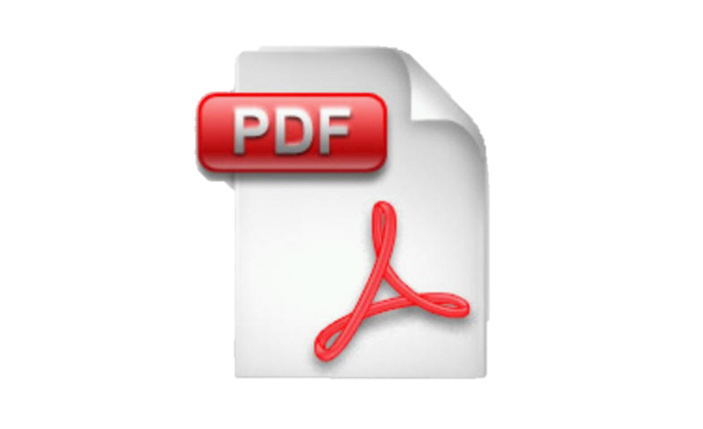
Buzzword Bingo
Re-usable extension
Rapid Development
Continuous build
Continuous delivery
Release automation
Deployment automation
Notes:
Re-usable extension with same code base 2010, 2013, O365.
Spend less time writing code
Automate build
Have latest extension version auto deploy to staging
Formal release of changes.
Check changes before release.
Make latest version available to consultants
Minimize overhead of Winword, PDF and user interaction.

Slide 7
Rapid Development
Open Source Technologies
  Project templating (Yeoman)
  Editor (VS Code)
  Typescript
  Task runner (Gulp)
Up to date dependencies
  NPM
  Bower
  Typings
Features
  Live reloading
  Source maps
  Web Part Properties
Notes:
Make live easy for a developer.
Use tools for normal web site development. => Many people use them.

Slide 8
DEMO
Develop a new web part with Visual Studio Code

Slide 9
Continuous build and delivery
Build code in VSTS on every change
Run tests
Deploy to showcase environment
Release Manager in VSTS
  Review changes
  Review test results
  Approval
  Notification
Release to NuGet feed
  Central storage of extensions
Notes:
Cover 3 minutes to let build finish.
Associate changes with task is recommendation. Makes life later easier. At least meaningful comments.
Change is small. Especially in GIT. Usually an hour of work. Only a few files.
Test driven development :
For demo excluded
JavaScript no exclusion.
If JavaScript fails and page does not work user does not care why.
Heaps of Frameworks available
Deploy after build :
Environment : Latest / Staging
For testing and showcase
Release Manager:
See changes since last release.
Setup deferred approval
Can be completely automated

Slide 10
DEMO
Continuous build and delivery in action
Deployment to Showcase

Slide 11
Deployment
Consultant access feed for install of extension
  Always latest version
Requires:
  Internet access
  Access to target SharePoint
  WMF5.0 / Windows 10
Notes:
SharePoint access: no admin only site collection

Slide 12
DEMO
Consume feed

Slide 13
Solution
Notes:
Developer:
Yeoman (Node JS - templating tool) to create project based on template.
Writing in VS Code
Gulp (Nodes JS – Task runner) to
Type script compile
Combine and minimize files
Upload to SharePoint Online
Development in a separate SharePoint Online Dev instance.
Source Control VSTS
Auto deploy to a SharePoint Online Showcase instance.
Release via VSTS Release manager to a package repository.
Consultant small static PowerShell to deploy package.

Slide 14
Conclusion
Minimize time to build extension
Minimize time to roll out extension
Versatile (Web Part, JSLink, User Custom Action, Ribbon)
Concentrate on the work
  Deployment to production is no-brainer
No stash of old versions
Only free services and tools are used
SharePoint Framework
  Same same but different
  Compatibility vs Mobile first
  Make yourself comfortable with the Toolchain
Notes:
I have used it to learn state of the art toolchain for web development
SharePoint (On Premises) has history of mediocre Toolchain.
This uses Open source which is actively developed by a lot of people.
From bug fixed to available for everybody 5 minutes
On Error Roll forward instead of Roll back
Showed Web Part. Also used for JSScriptlink (extension run all pages).
Concentrate => less hassle
No wallet was hurt for this presentation.
SharePoint Framework compare:
Same ingredients → Make yourself comfortable with them
Focused on mobile first
First release Q4 2016
My solution
Compatibility first
Now

Slide 15
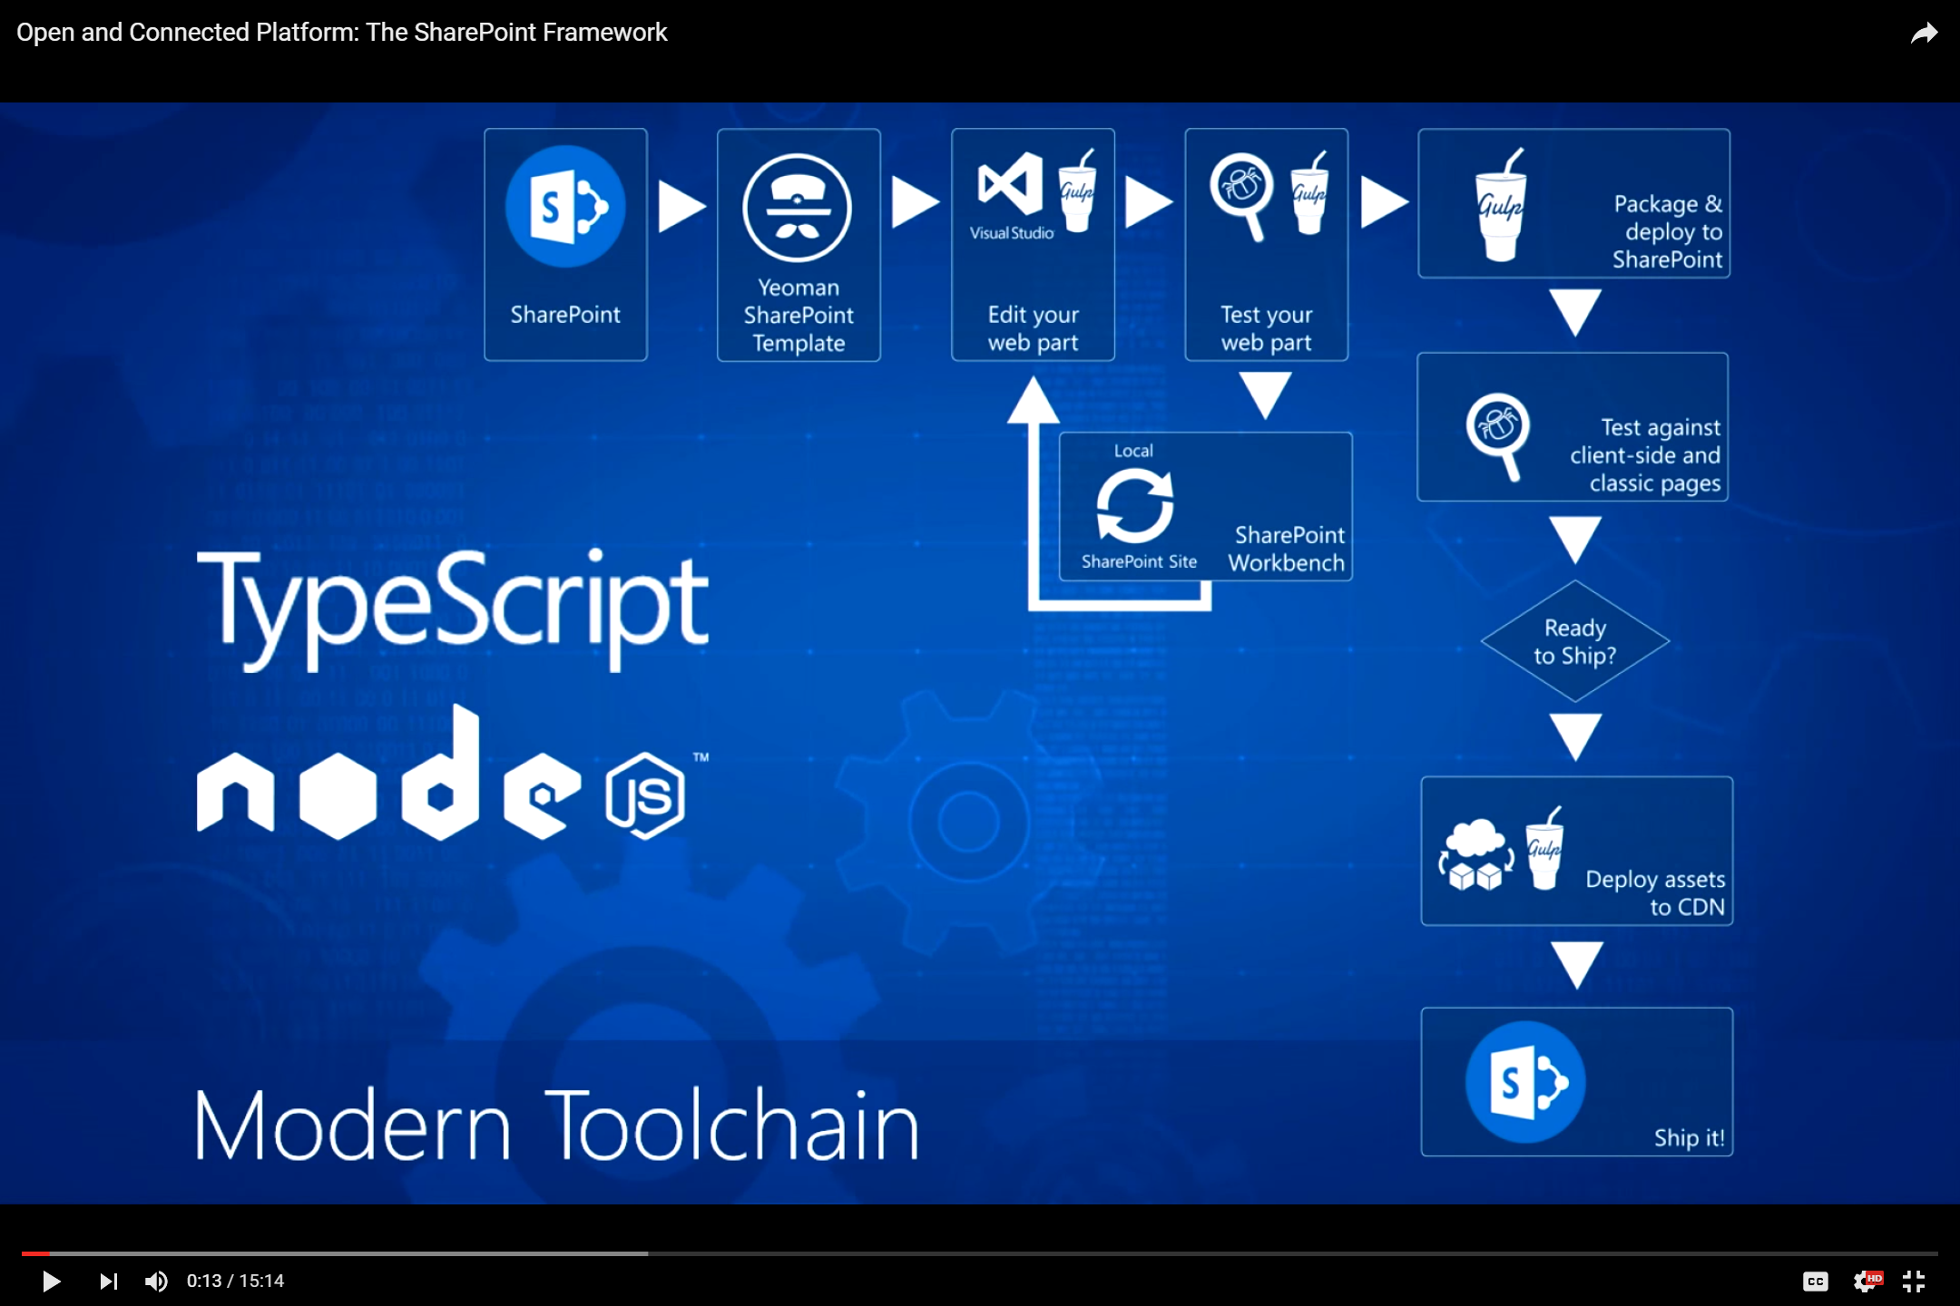
Source:
http://youtu.be/
T_bGyqKwT4g
Notes:
Source: https://www.youtube.com/watch?v=T_bGyqKwT4g

Slide 16
Thank you!
Questions?
Fabian Schmidt
Fabian@Schmidtie.net
Sources: https://github.com/Fabian-Schmidt/SharePoint-Toolchain/

